Slide 1

David M. Kroenke and David J. Auer Database Processing: Fundamentals, Design, and Implementation
Chapter Ten A:
Managing Databases with
SQL Server 2014
Part 1: Installing SQL Server and Building the Cape Codd Database

Slide 2
Chapter Objectives
To install SQL Server 2014
To use SQL Server 2014’s graphical utilities
To create a database in SQL Server 2014
To submit both SQL DDL and DML via the Microsoft SQL Server Management Studio
To import Microsoft Excel worksheet data into a
database table
To understand the use of SQL/Persistent Stored Modules (SQL/PSM) in Microsoft Transact-SQL
To understand the purpose and role of user-defined functions and know how to create simple user-defined functions

Slide 3
Chapter Objectives
To understand the purpose and role of stored procedures and know how to create simple stored procedures
To understand the purpose and role of triggers and know how to create simple triggers
To understand how SQL Server implements indexes, concurrency control and cursors
To understand the SQL Server security model
To understand the fundamental features of SQL Server backup and recovery facilities

Slide 4
Scope
The PowerPoint slide show covers the first four objectives.
In particular:
How to install Microsoft SQL Server 2014.
How to use the SQL Server Management Studio.
How to create a SQL Server 2014 database.
How to use existing SQL scripts to build and populate the Cape Codd database used for SQL DML work in Chapter 2.

Slide 5
Introduction I
There are several versions of SQL Server 2014, of which five are significant for our purposes:
Enterprise Edition—This is the most powerful and feature-laden version. It handles up to the maximum number of CPUs or CPU cores allowed by the OS, the maximum memory allowed, and a maximum database size of 524 Petabytes (PBytes). It includes full data warehouse capabilities and business intelligence capabilities.
Business Intelligence Edition—It handles up to four CPUs or 16 CPU cores (limited to the lessor of 4 CPUs or 16 cores), 64 GBytes of memory and a maximum database size of 524 Petabytes (PBytes). It includes full data warehouse capabilities.
Standard Edition—This is the basic commercial version. It handles up to four CPUs or 16 CPU cores (limited to the lessor of 4 CPUs or 16 cores), 64 GBytes of memory and a maximum database size of 524 PBytes. It has limited data warehouse capabilities.

Slide 6
Introduction II
There are several versions of SQL Server 2014, of which five are significant for our purposes:
Developer Edition—This is a single-user version of the Enterprise Edition, intended for use by a single person doing database and application development work.
Express Edition—This free, feature-limited version is available for download. It supports one CPU or four CPU cores (limited to the lessor of 1 CPUs or 4 cores), one GByte of memory, and a maximum database size of 10 GBytes. Despite its limitations, it is a great learning tool when the Express Advanced version, which includes the SQL Server 2014 Management Studio and a basic reporting services package, is used.
The Express Advanced Edition includes SQL Server Reporting Services and the SQL Server Management Studio GUI utility.
Notes:
The SQL Server Express Edition was introduced with SQL Server 2005, and SQL Server 2014 includes the SQL Server 2014 Express Edition.
The SQL Server Express editions seem to be designed to compete with Oracle Corporation’s MySQL (see Chapter 10C). Although MySQL does not have as many features as SQL Server, it is an open source database that has had the advantage of being available for download over the Internet at no cost. It has become widely used and very popular as a DBMS, supporting Web sites running the Apache Web server.

Slide 7
Installing Microsoft SQL Server 2014 Prerequisites – Install These
.Net Framework 3.5
.Net Framework 4.5
Microsoft Visual C++ 2008 SP1 Redistributable
Microsoft Visual C++ 2010 SP1 Redistributable
Microsoft Visual C++ Redistributable for Visual Studio 2012 Update 4
Microsoft Visual C++ Redistributable for Visual Studio 2013
2007 Office System Driver: Data Connectivity Components.
Notes:
.Net Framework 3.5 is provided with the Windows OS, but it may not be enabled by default. In Windows 8.1, use Control Panel | Programs | Programs and Features | Turn Windows Features On or Off to install .Net Framework 3.5. In Windows Server 2012, use Server Manager | Manage | Add Roles and Features to launch the Add Roles and Features Wizard to install .Net Framework 3.5.
.Net Framework 4.5 is provided with the Windows OS and should be enabled by default. In Windows 8.1, use Control Panel | Programs | Programs and Features | Turn Windows Features On or Off to install .Net Framework 4.5. In Windows Server 2012, use Server Manager | Manage | Add Roles and Features to launch the Add Roles and Features Wizard to install .Net Framework 4.5. This will actually be .Net Framework 4.5.1, which is the version provided with Windows 8.1 and Windows Server 2012 R2,
For the other products listed, download them from http://www.microsoft.com/en-us/download/ .

Slide 8
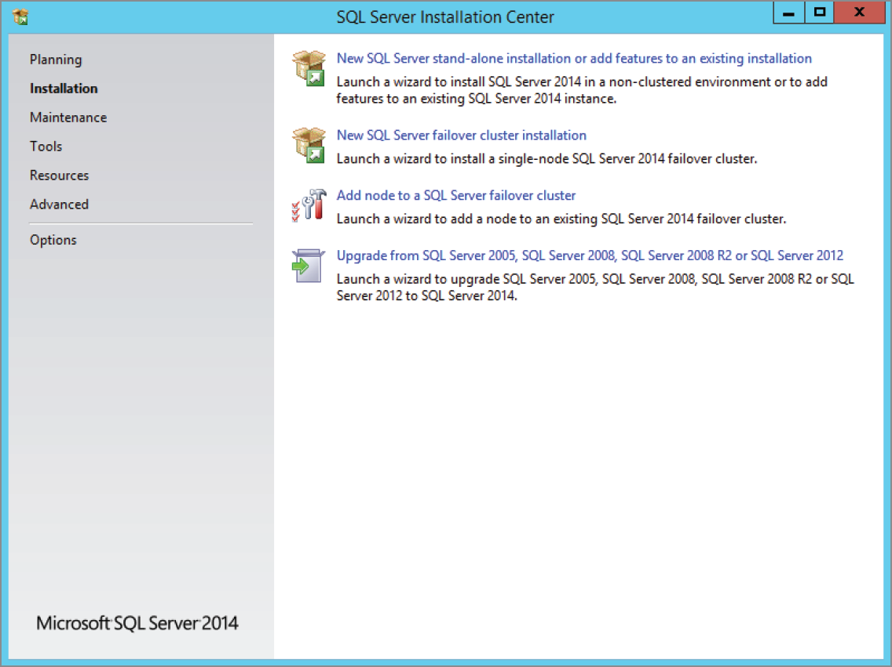
Installing Microsoft SQL Server 2014 The SQL Server Installation Center Dialog Box

Slide 9
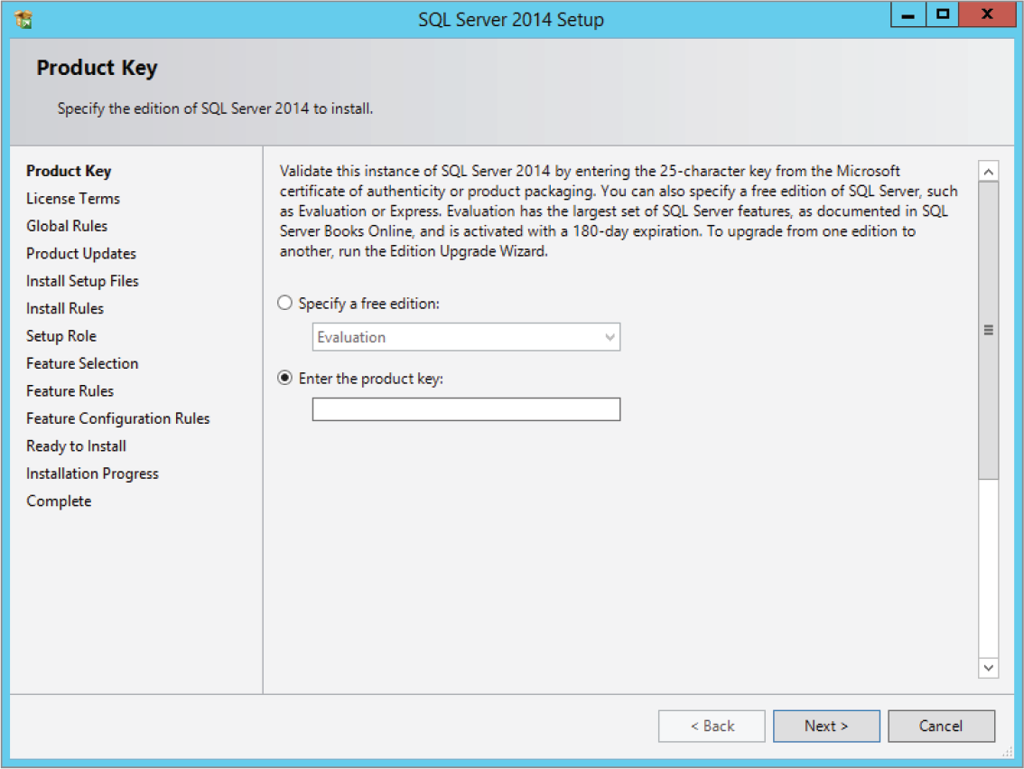
Installing Microsoft SQL Server 2014 The SQL Server 2014 Setup Product Key Page

Slide 10
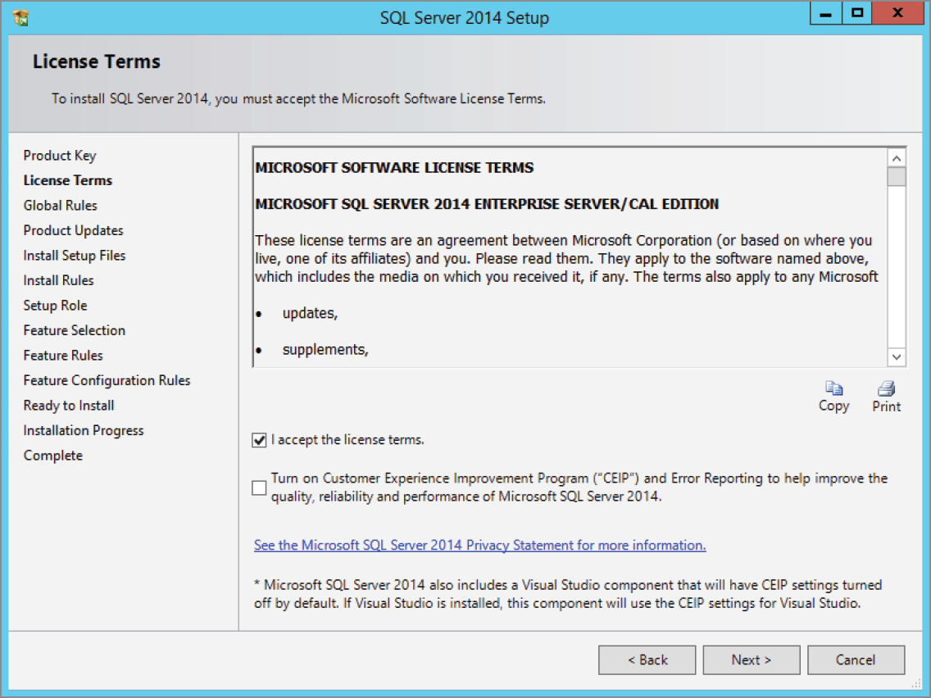
Installing Microsoft SQL Server 2014 The SQL Server 2014 Setup License Terms Page

Slide 11
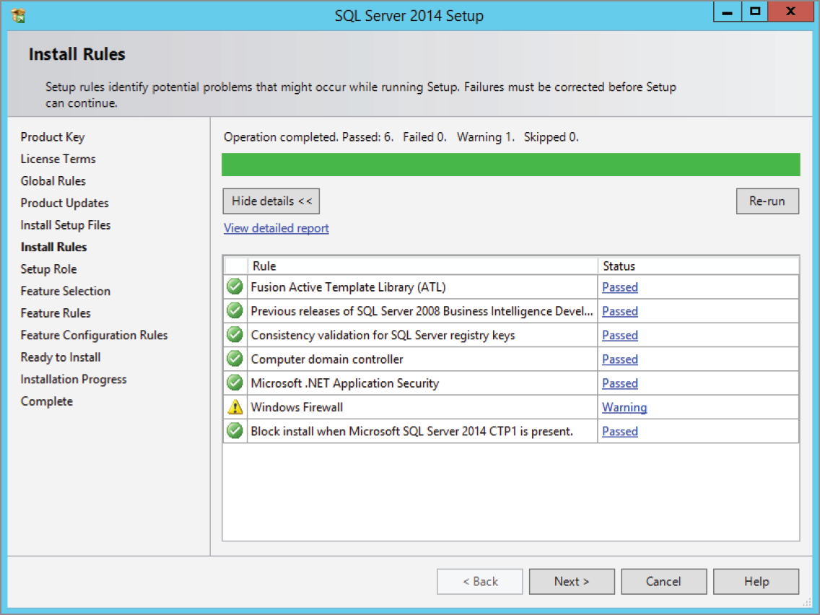
Installing Microsoft SQL Server 2014 The SQL Server 2014 Setup Install Rules Page

Slide 12
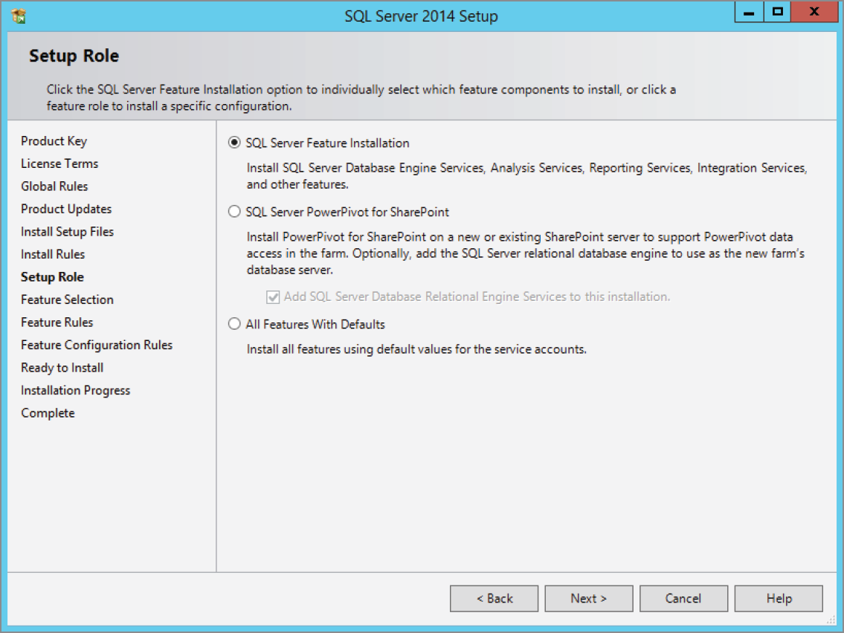
Installing Microsoft SQL Server 2014 The SQL Server 2014 Setup Role Page

Slide 13
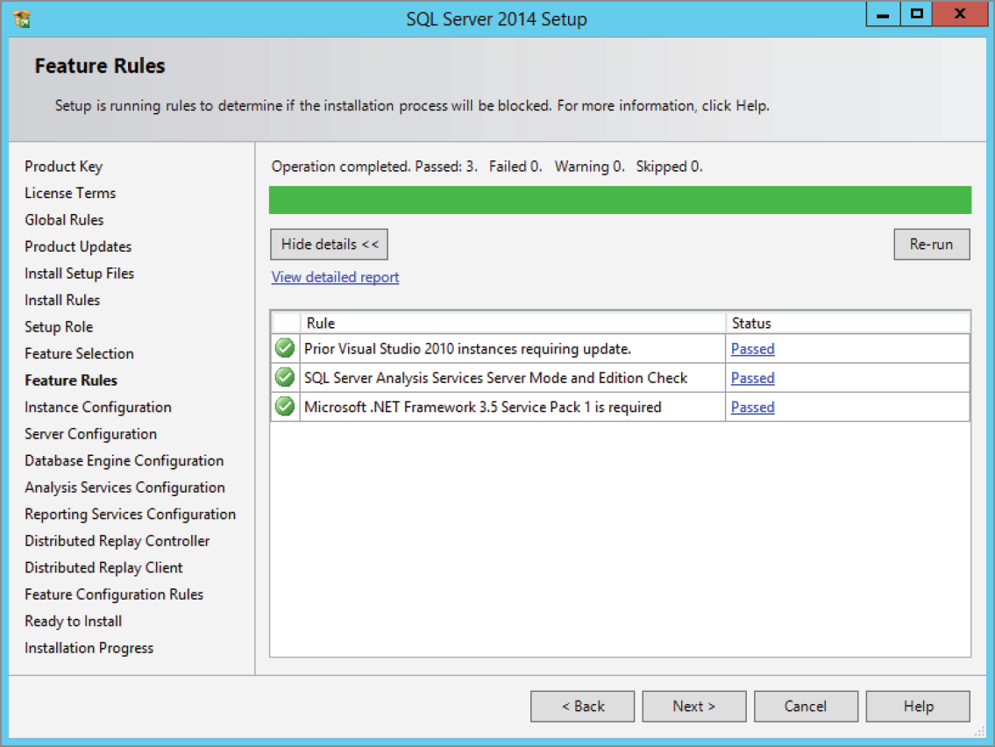
Installing Microsoft SQL Server 2014 The SQL Server 2014 Setup Feature Rules Page

Slide 14
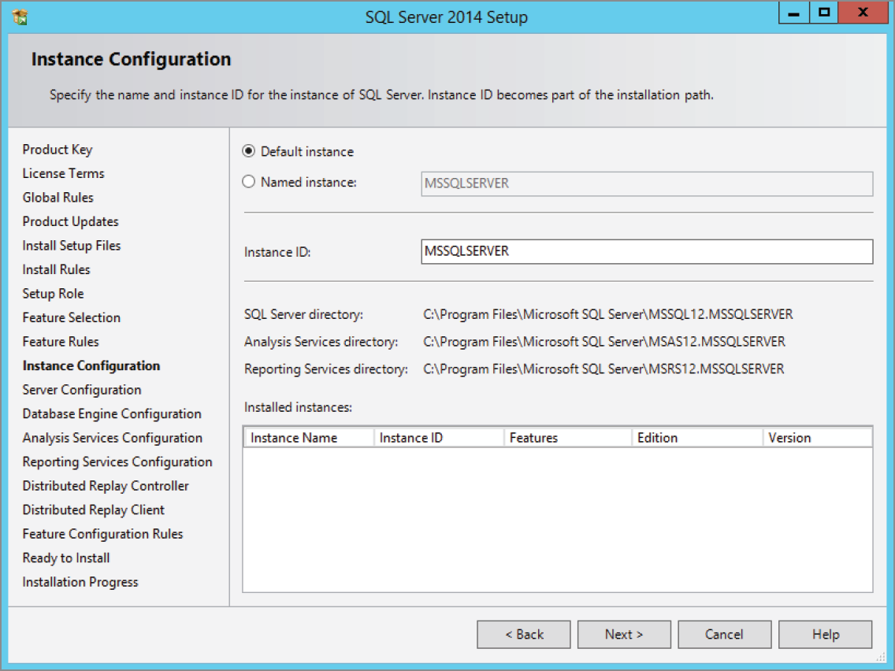
Installing Microsoft SQL Server 2014 The SQL Server 2014 Setup Instance Configuration Page

Slide 15
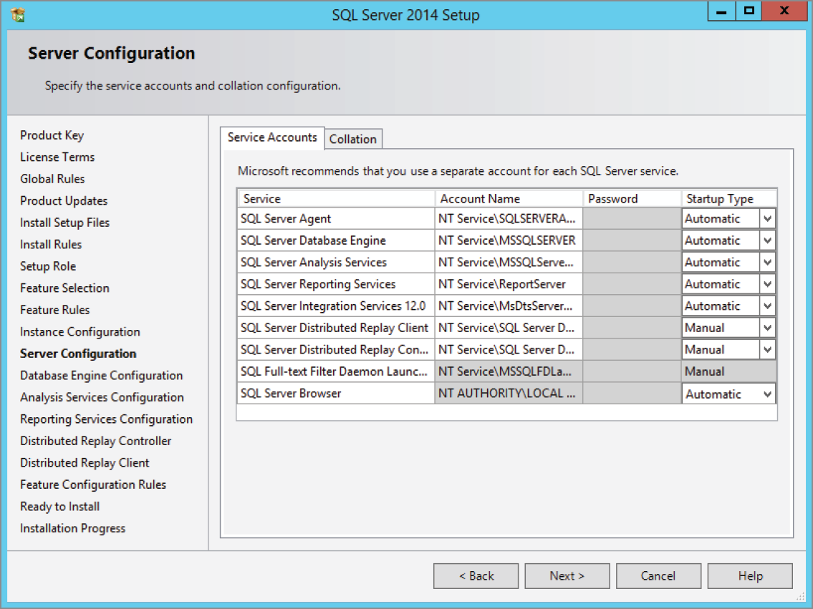
Installing Microsoft SQL Server 2014 The SQL Server 2014 Setup Server Configuration Page

Slide 16
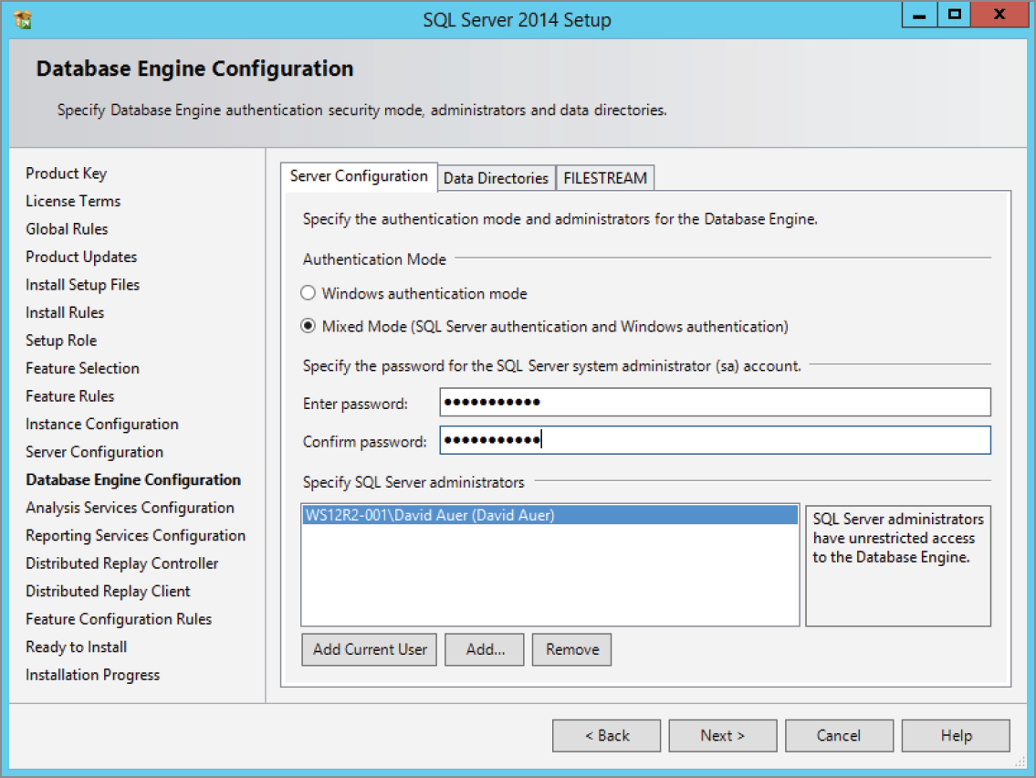
Installing Microsoft SQL Server 2014 The SQL Server 2014 Setup Database Engine Configuration Page

Slide 17
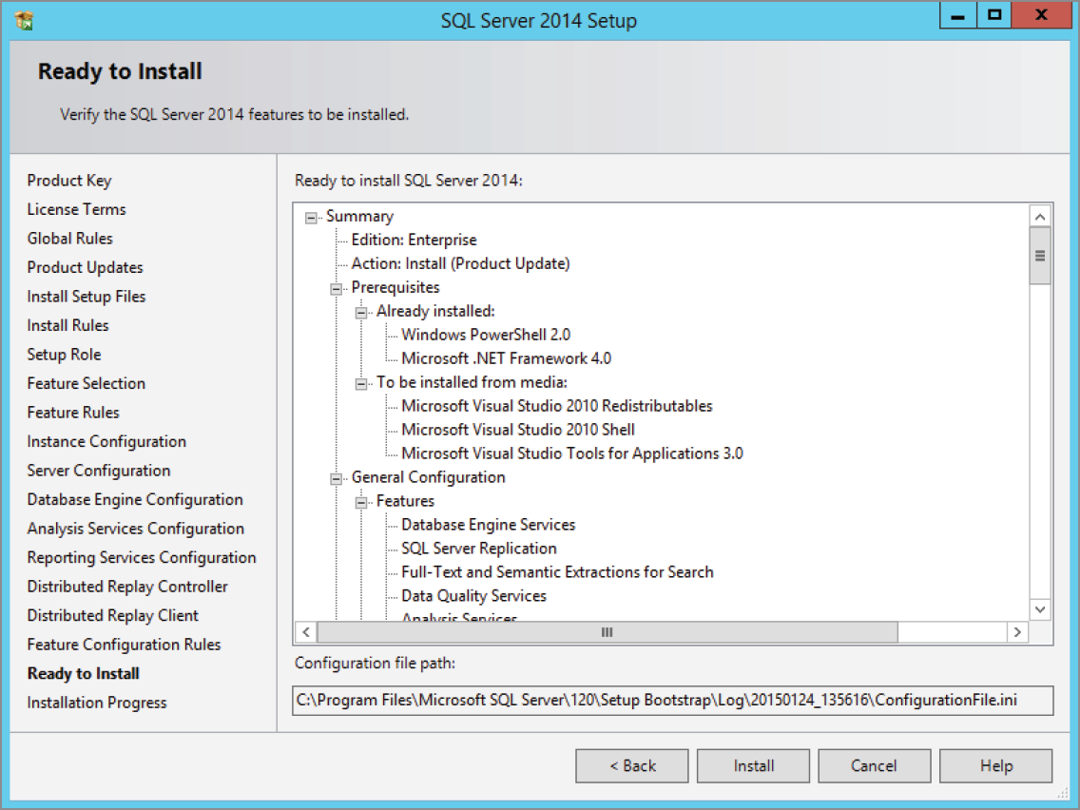
Installing Microsoft SQL Server 2014 The SQL Server 2014 Setup Ready To Install Page

Slide 18
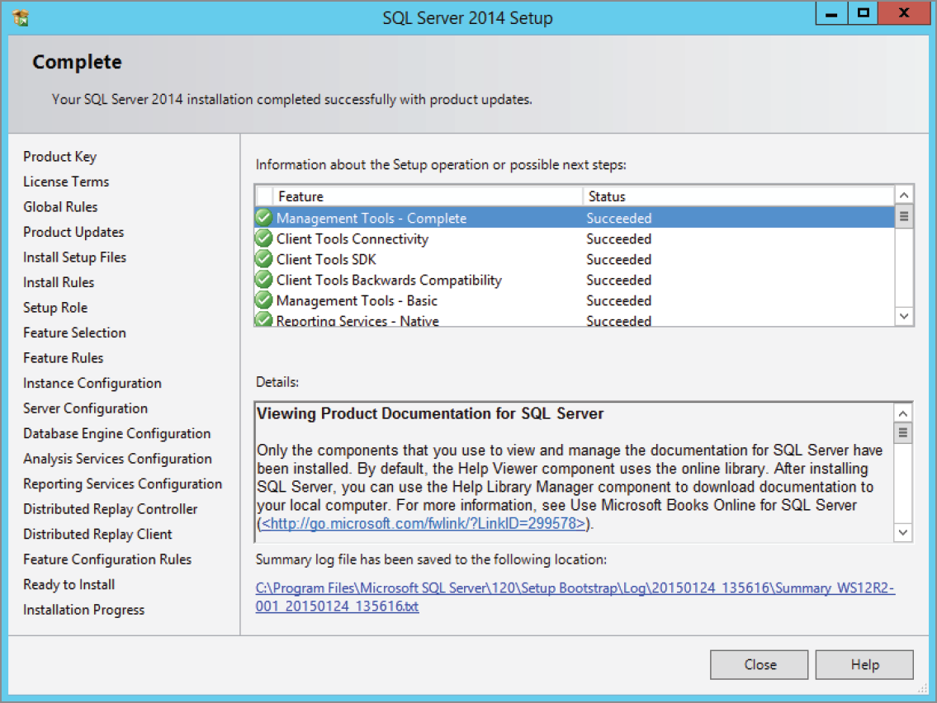
Installing Microsoft SQL Server 2014 The SQL Server 2014 Setup Complete Page

Slide 19
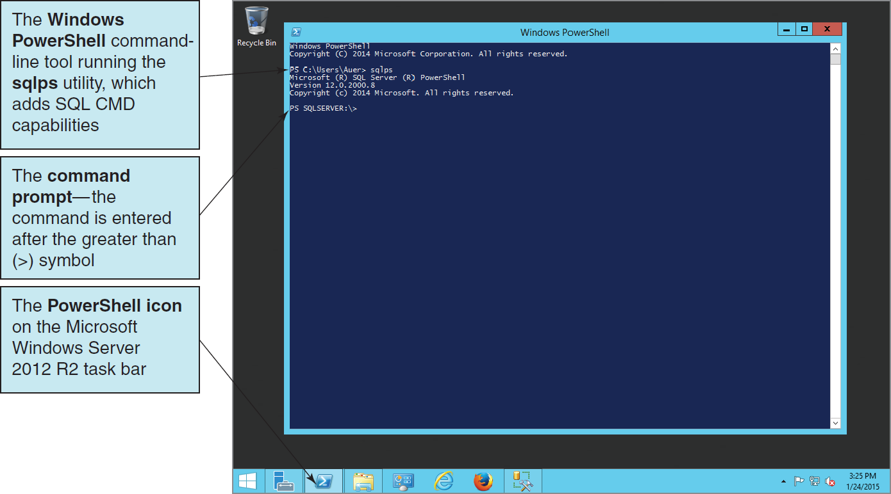
SQL Server 2014 Utilities: Microsoft PowerShell and sqlps Utility

Slide 20
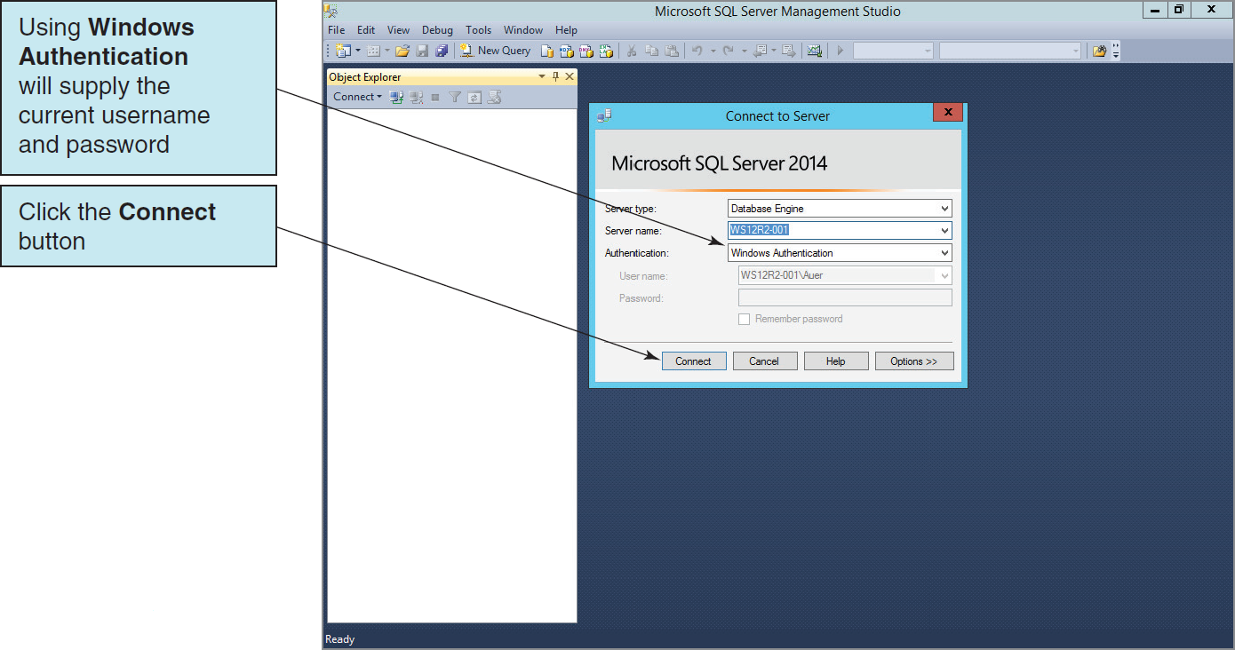
SQL Server 2014 Utilities: Microsoft SQL Server Management Studio I

Slide 21
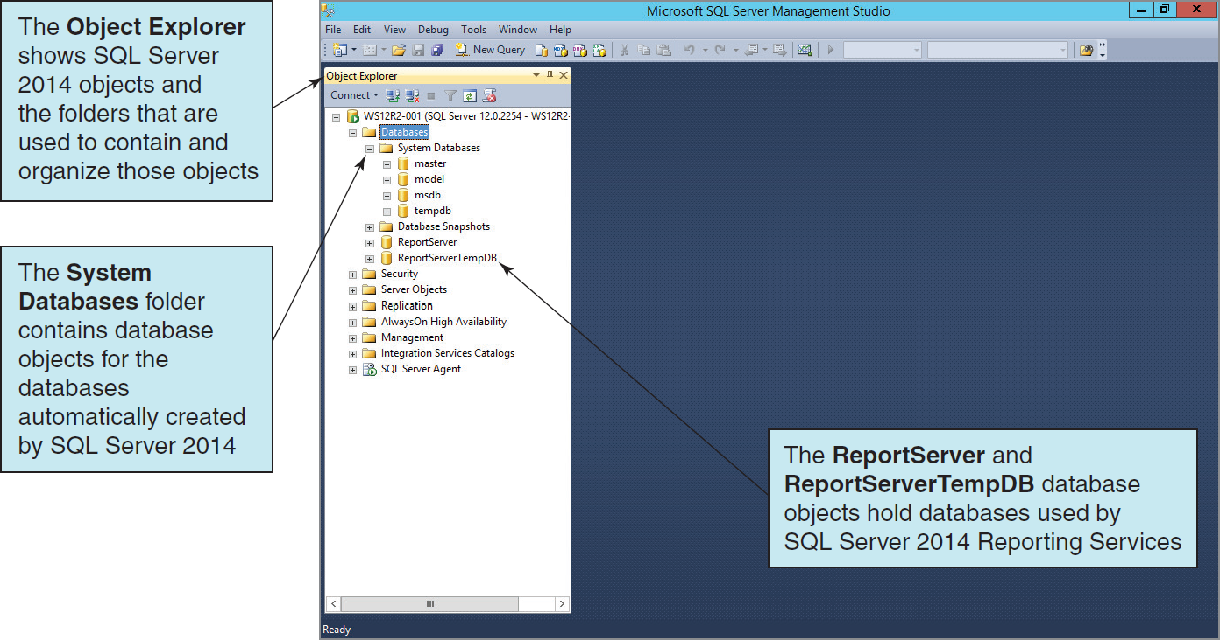
SQL Server 2014 Utilities: Microsoft SQL Server Management Studio II

Slide 22
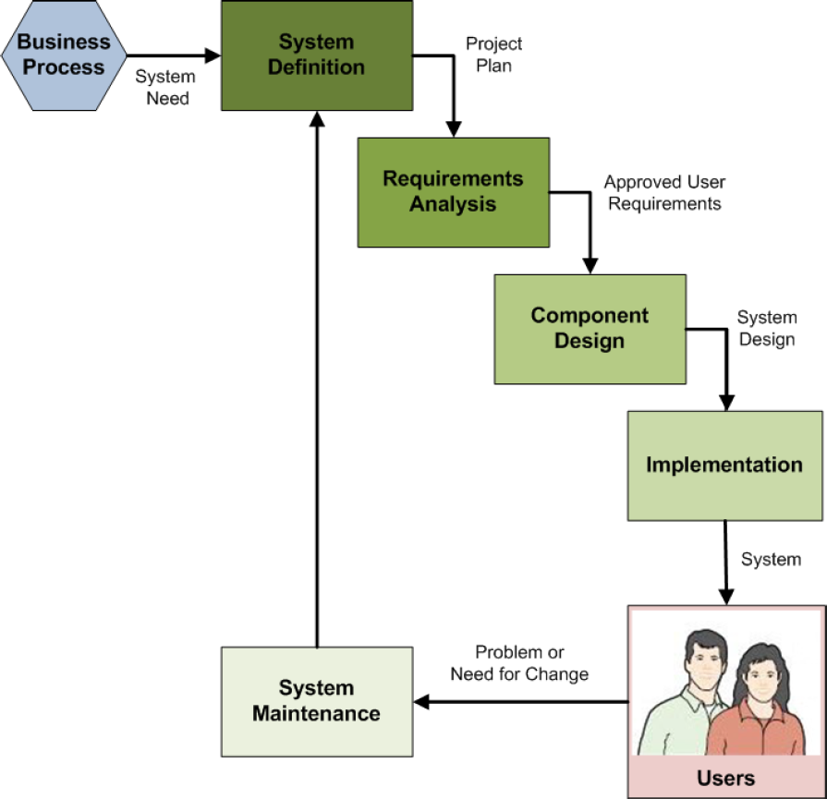
Database Implementation in the SDLC
The systems development life cycle (SDLC) as discussed in Appendix B
Database construction occurs in the implementation step of the SDLC
The final database is part of the final system ready for users to use
Notes:
Books on systems analysis and design often identify three design stages:
■ Conceptual design (conceptual schema)
■ Logical design (logical schema)
■ Physical design (physical schema)
The creation and use of file structure and file organization (including physical storage placement and file characteristics) to store database components and physical records of data are a part of the physical design, which is defined in these books as the aspects of the database that are actually implemented in the DBMS. Besides physical record and file structure and organization, this includes indexes and query optimization.

Slide 23
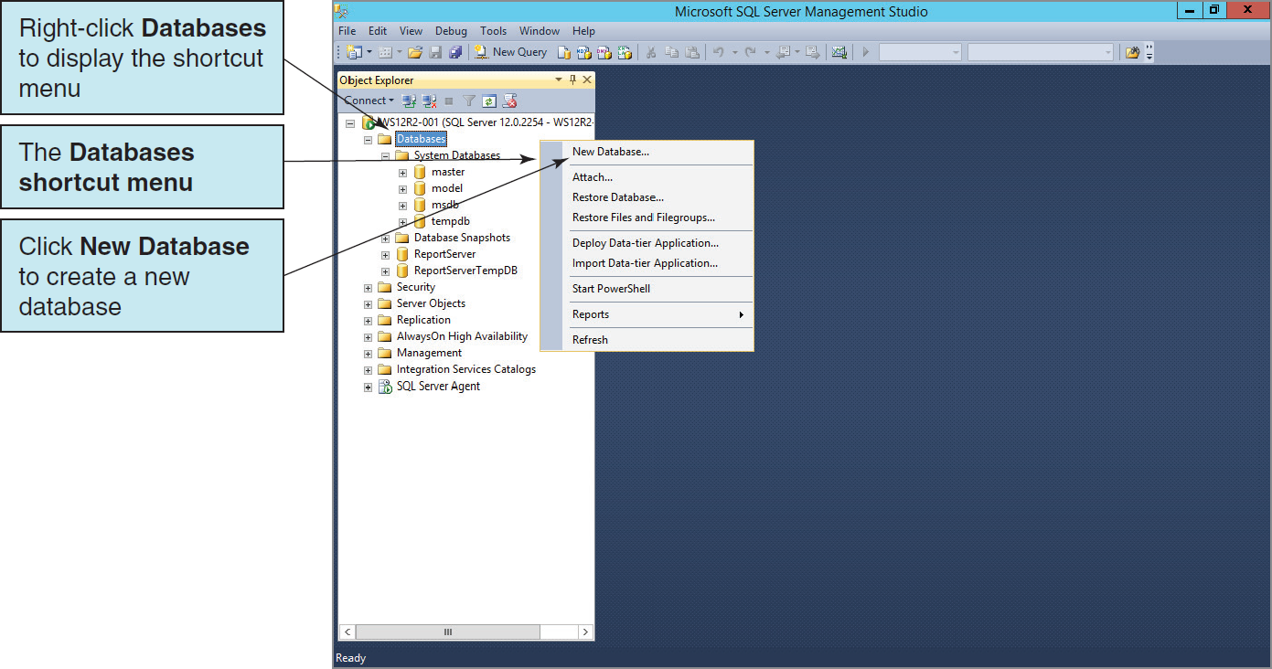
Creating a New Database I

Slide 24
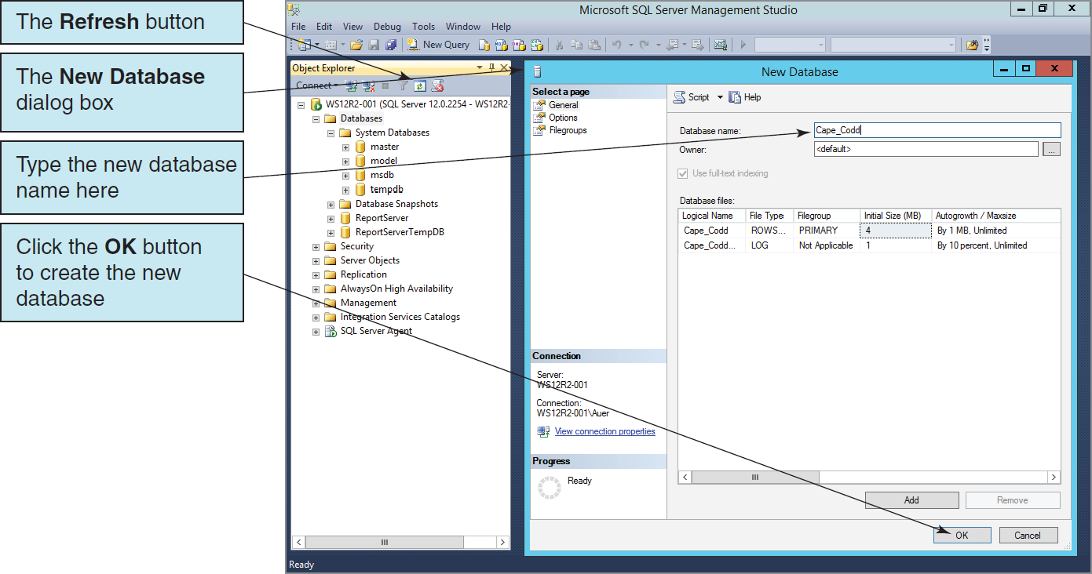
Creating a New Database II

Slide 25
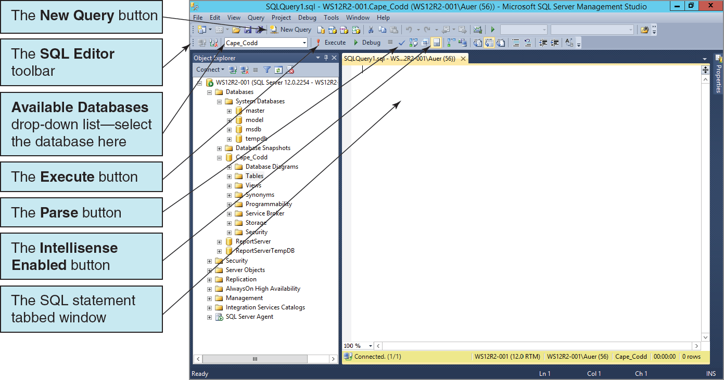
SQL Server 2014 Utilities: Microsoft SQL Server Management Studio III

Slide 26
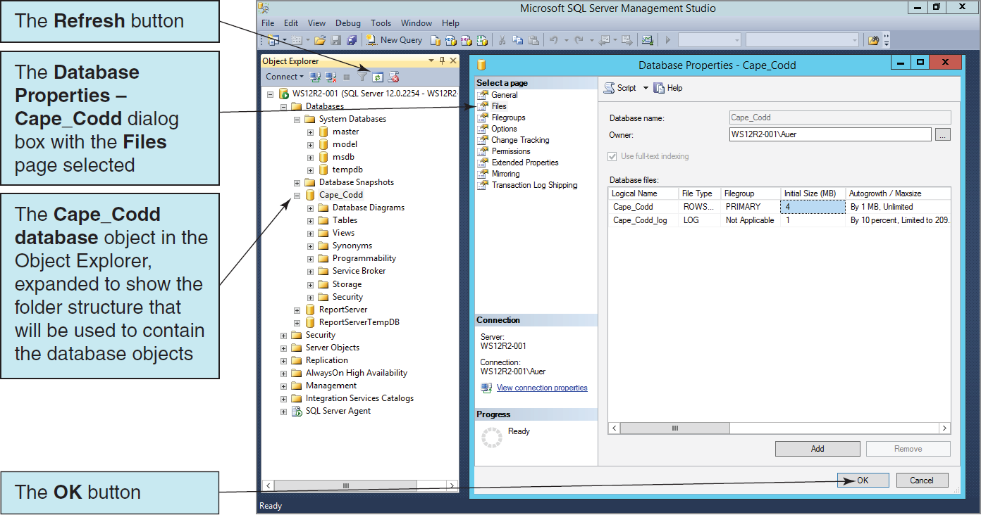
Viewing the New Database

Slide 27
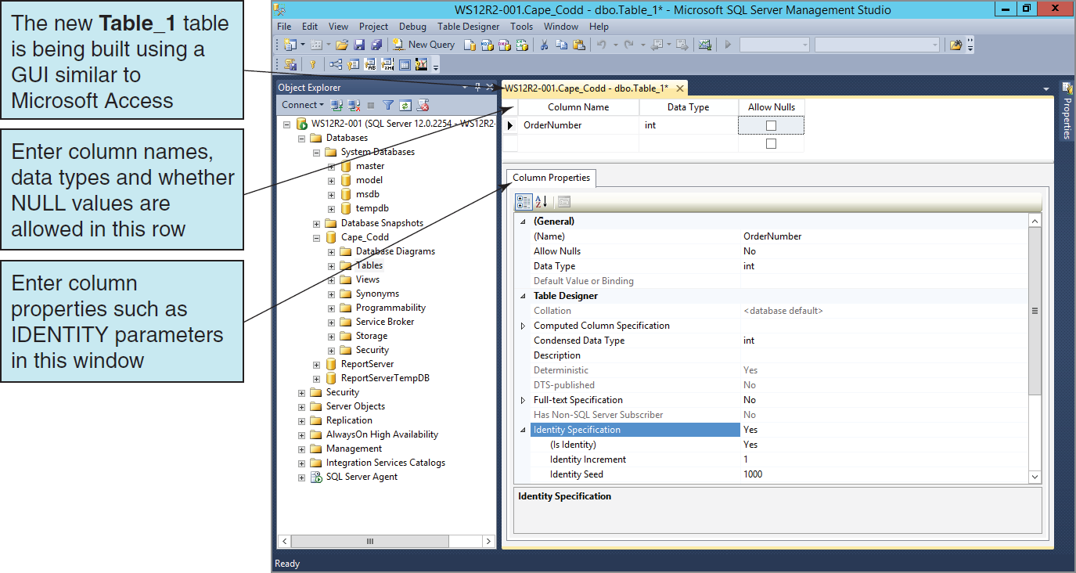
The GUI Table Editor

Slide 28
SQL Scripts
An SQL script is a plaintext file labeled with the .sql file extension.
An SQL script is composed of one or more SQL statements, which can include SQL script comments.
SQL script comments are lines of text that do not run when the script is executed but are used to document the purpose and contents of the script. Each comment begins with the characters /* (slash asterisk) and ends with the characters */ (asterisk slash). Alternatively, for a single line comment (or a comment at the end of a line), we use – – (two dashes) at the start of the comment.

Slide 29
Cape Codd Database Available Online I
Another advantage of SQL scripts is that we can use scripts written by others.
Versions of the complete Cape Codd database are available in the downloadable Student Files available at:
http://www.pearsonhighered.com/kroenke/
These include versions for:
Microsoft Access 2013
Microsoft SQL Server 2014
Oracle Database 12c and Oracle Database XE
MySQL 5.6
We recommend you actually run all material in a live database!

Slide 30
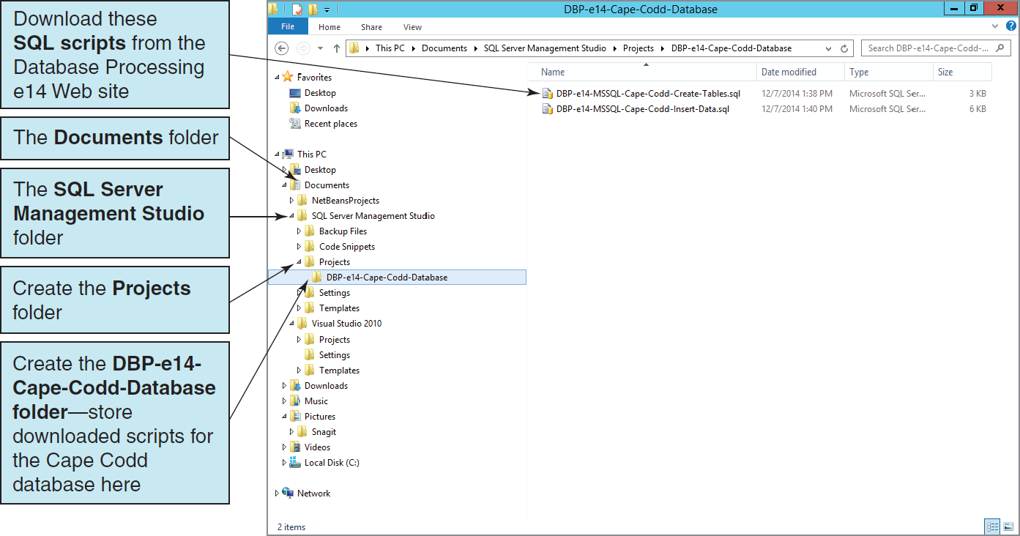
Using Existing SQL Scripts I Creating the File System Structure

Slide 31
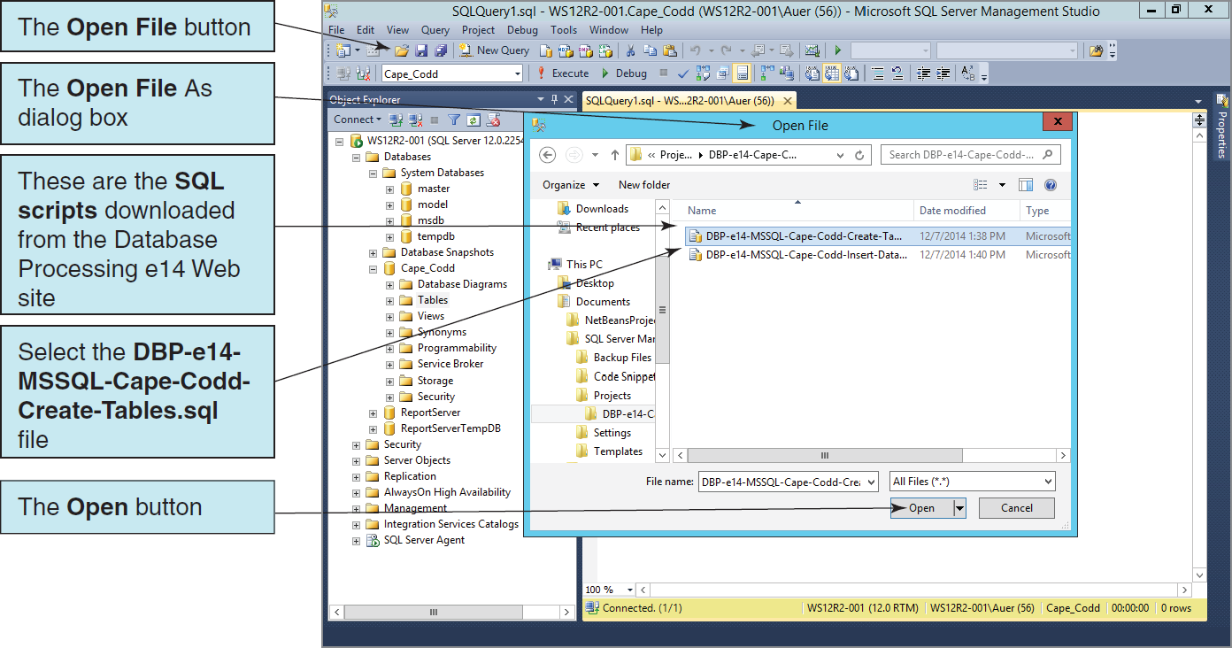
Using Existing SQL Scripts II Opening the Existing SQL Script

Slide 32
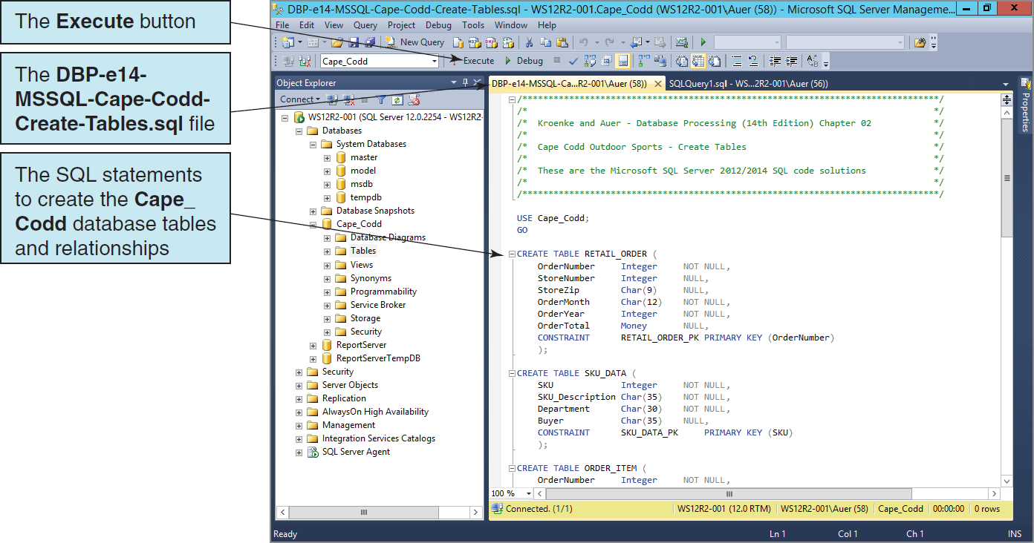
Using Existing SQL Scripts III Running the Existing SQL Script

Slide 33
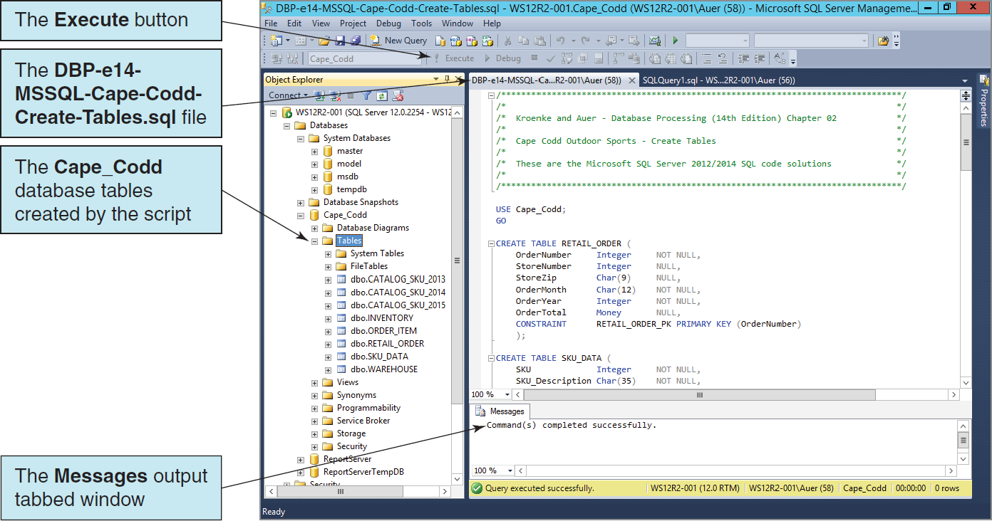
Using Existing SQL Scripts IV The Cape Codd Database Table Objects in Object Explorer

Slide 34
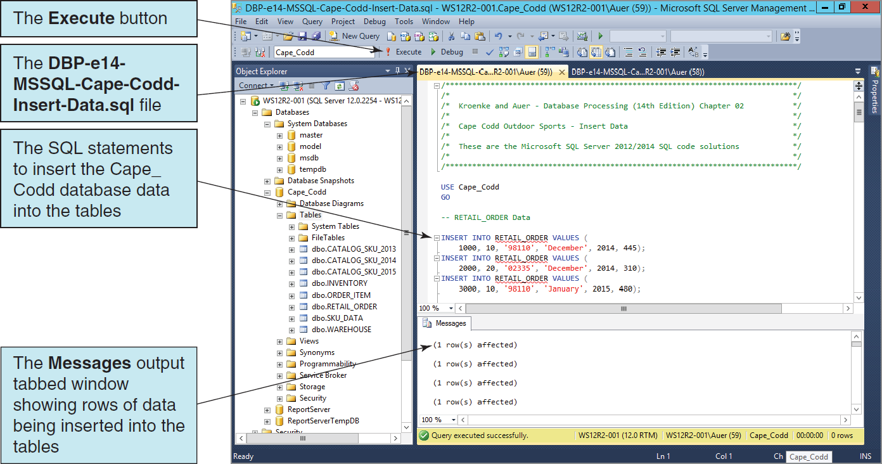
Using Existing SQL Scripts V Populating the Cape Codd Database Tables

Slide 35
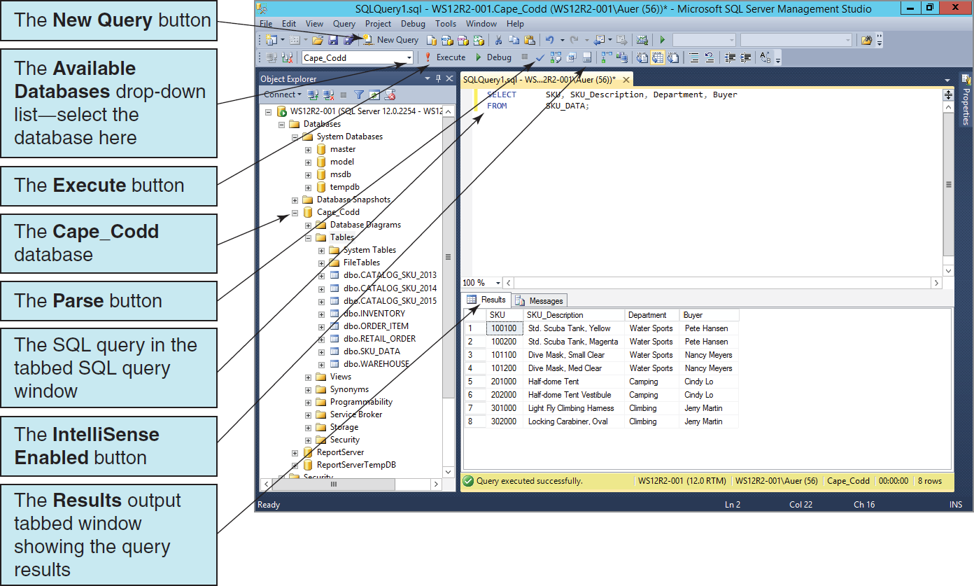
Querying the Cape Codd Database

Slide 36
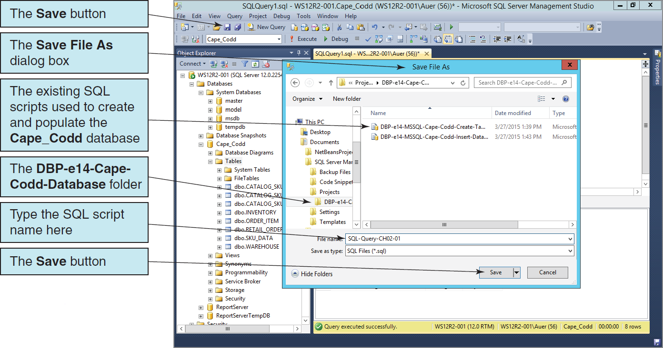
Saving an SQL Script

Slide 37
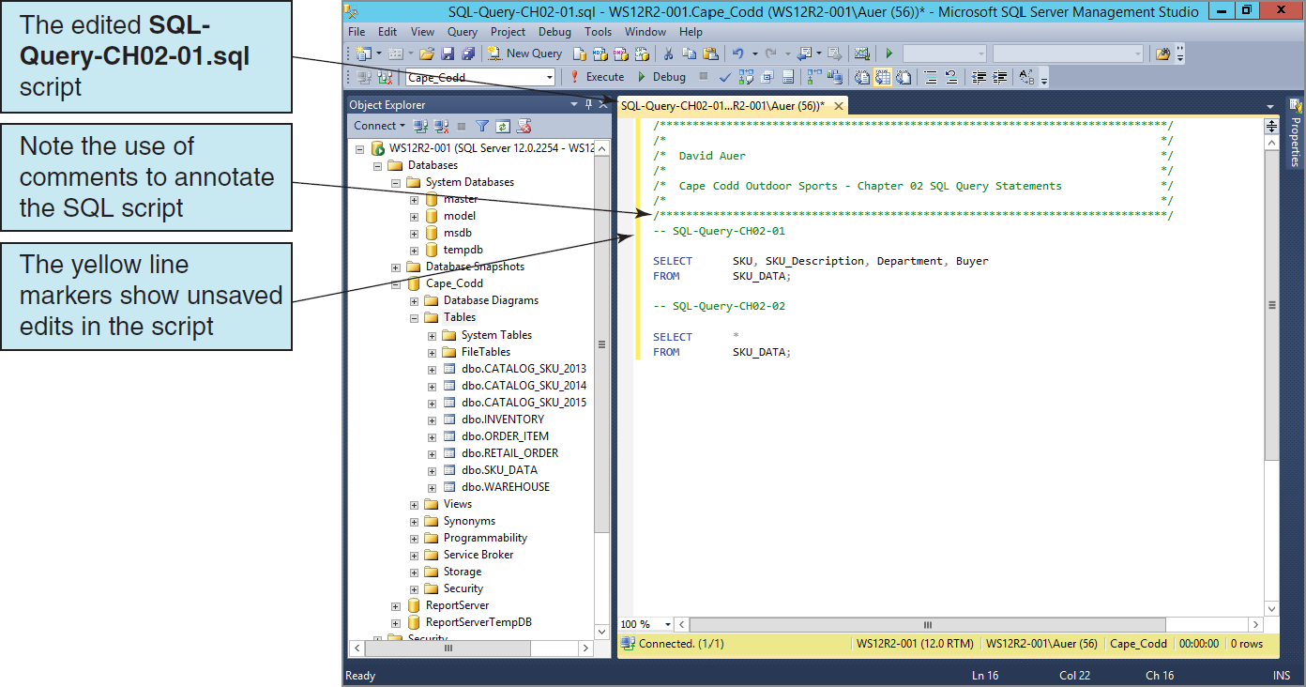
Editing an SQL Script

Slide 38
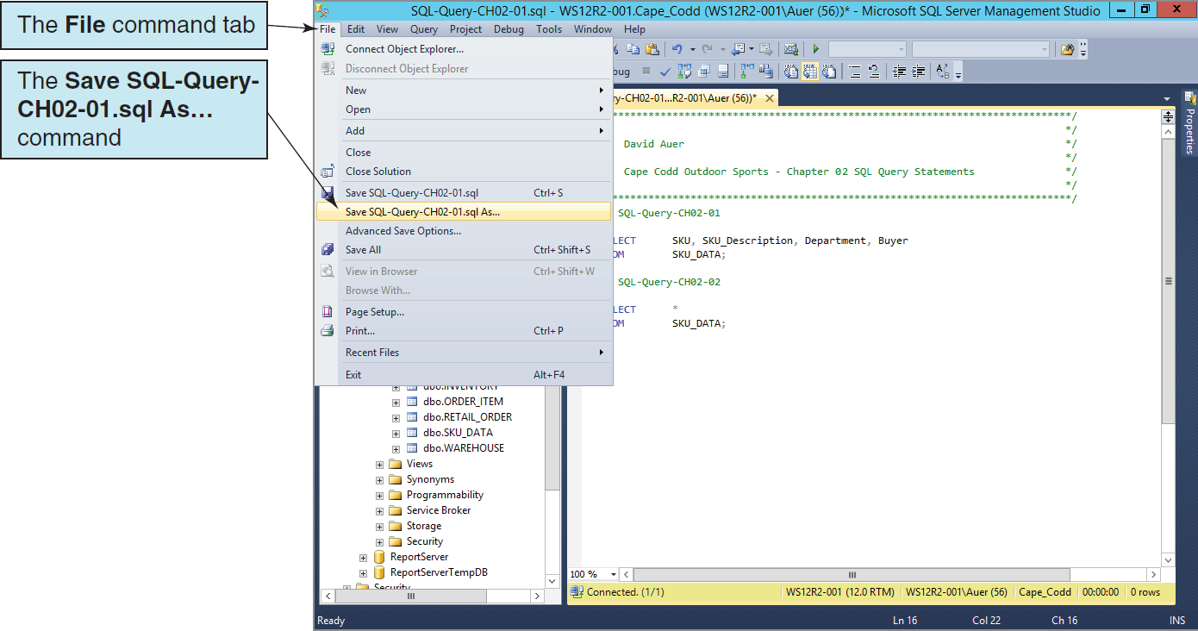
Saving an SQL Script with a Different File Name

Slide 39
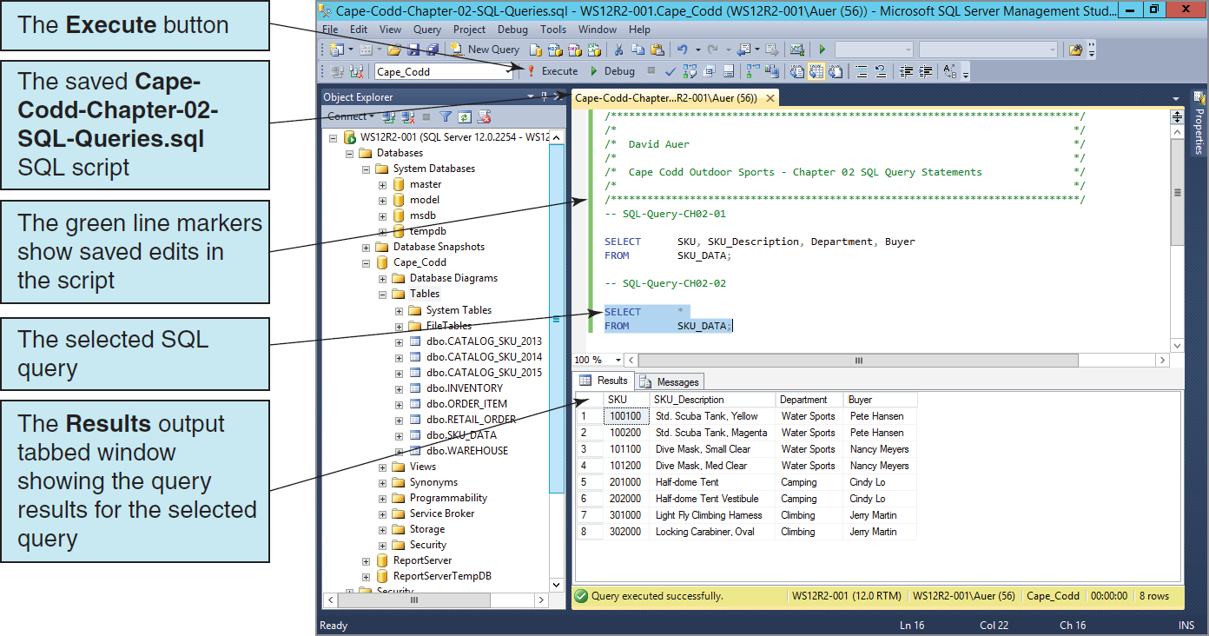
The Renamed SQL Script
Notes:
At this point you have covered all the material about Microsoft SQL Server 2014 that you need to work with the SQL query statements in Chapter 2. If you worked through this material because of the directions in the Using SQL in Microsoft SQL Server 2014 section on pages 53–56, you should return to that section at this time and continue your work on SQL query statements.
Use the new Cape-Codd-Chapter-02-SQL-Queries.sql script to store all your work in Chapter 02—that will be much easier and more efficient that storing a separate SQL script for each query!

Slide 40
David Kroenke and David Auer Database Processing Fundamentals, Design, and Implementation (14th Edition)
End of Presentation:
Chapter Ten A Part 1

Slide 41

All rights reserved. No part of this publication may be reproduced, stored in a retrieval system, or transmitted, in any form or by any means, electronic, mechanical, photocopying, recording, or otherwise, without the prior written permission of the publisher. Printed in the United States of America.

